Slide 1
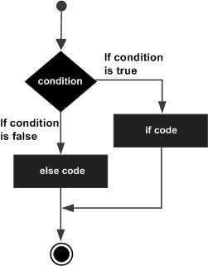
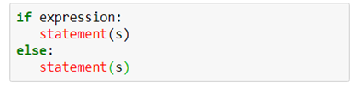
Conditional Statements if-else
An if statement can be followed by an optional else statement, which executes when the Boolean expression is False.
An else statement can be combined with an if statement. An else statement contains the block of code that executes if the conditional expression in the if statement resolves to 0 or a False value.
The else statement is an optional statement and there could be at most only one else statement following if.

Slide 2
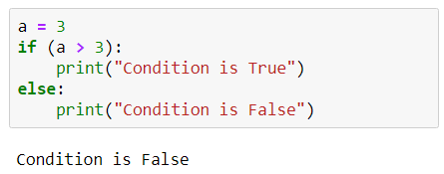
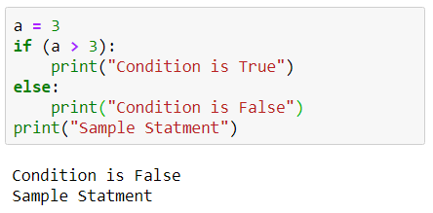
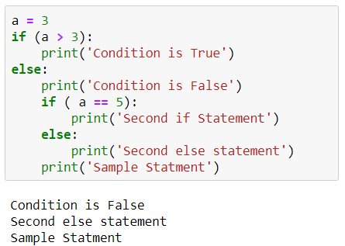
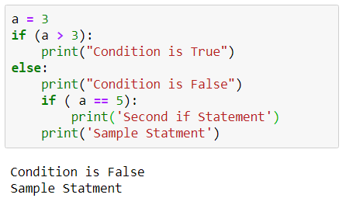
Conditional Statements if - else

Slide 3
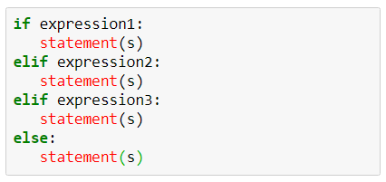
Conditional Statements if - elif
The elif statement allows one to check multiple expressions for True and execute a block of code as soon as one of the conditions evaluates to True.
Similar to the else, the elif statement is optional. However, unlike else, for which there can be at most one statement, there can be an arbitrary number of elif statements following an if.
Core Python does not provide switch or case statements as in other languages, but we can use if...elif statements to simulate switch case.

Slide 4
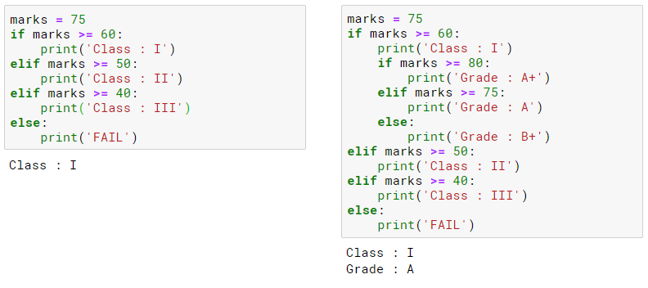
Conditional Statements if - elif

Slide 5
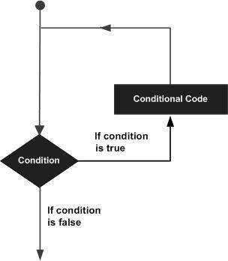
Looping Statements
In general, statements are executed sequentially. The first statement in a program is executed first, followed by the second, and so on. There may be a situation when one need to execute a block of code several number of times.
Python Programming language provide various control structures that allow for more complicated execution paths.
A loop statement allows us to execute a statement or group of statements multiple times. The diagram illustrates a loop statement.

Slide 6

Looping Statements While
A while loop statement in Python programming language repeatedly executes a target statement as long as a given condition is True.
Here, statement(s) may be a single statement or a block of statements. The condition may be any expression, and True is any non-zero value.
The loop iterates while the condition is True. When the condition becomes False, program control passes to the line immediately following the loop.
In Python, all the statements indented by the same number of character spaces after a programming construct are considered to be part of a single block of code. Python uses indentation as its method of grouping statements.
Key point of the while loop is that the loop might not ever run. When the condition is tested and the result is False, the loop body will be skipped and the first statement after the while loop will be executed.

Slide 7
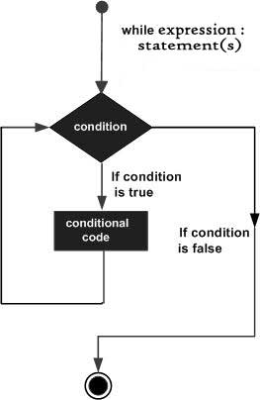
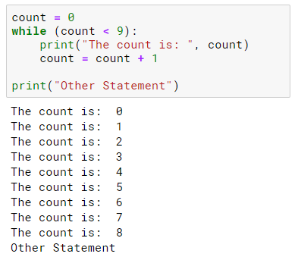
Looping Statements While

Slide 8
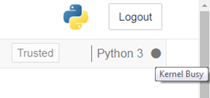
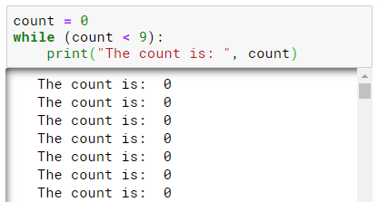
Looping Statements Infinite Loop
A loop becomes infinite loop if a condition never becomes False. One must use caution when using while loops because of the possibility that given condition never resolves to a False value. This results in a loop that never ends. Such a loop is called an infinite loop.
An infinite loop might be useful in client/server programming where the server needs to run continuously so that client programs can communicate with it as and when required.
When the given code is executed, it goes in an infinite loop. The Kernel of our Jupyter Notebook becomes Busy.

Slide 9

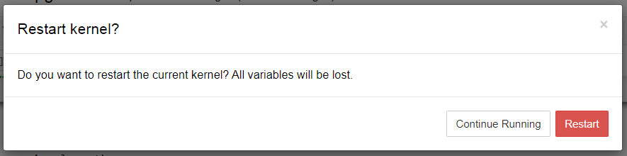
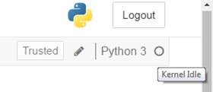
Looping Statements Infinite Loop
Steps to follow to interrupt the program running in infinite loop.
Locate the Restart button and click on it.
On the pop up dialog box ,click on Restart button.
Wait for Kernel to become Ideal again.

Slide 10

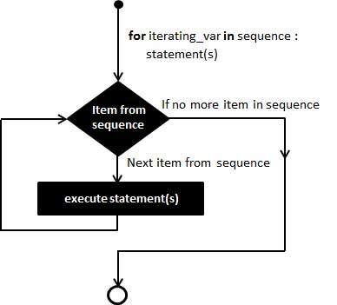
Looping Statements for
Executes a sequence of statements multiple times and abbreviates the code that manages the loop variable.
It has the ability to iterate over the items of any sequence, such as a list or a string.
If a sequence contains an expression list, it is evaluated first. Then, the first item in the sequence is assigned to the iterating variable iterating_var. Next, the statements block is executed.
Each item in the list is assigned to iterating_var, and the statement(s) block is executed until the entire sequence is exhausted.

Slide 11
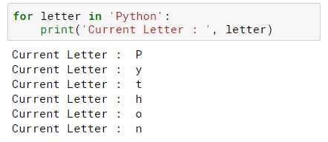
Looping Statements for
Notes:
Return an object that produces a sequence of integers from start (inclusive) | to stop (exclusive) by step.

Slide 12
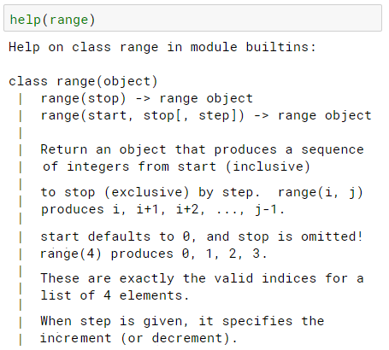
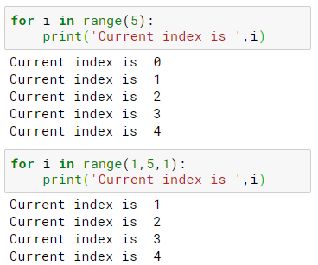

Looping Statements for
Notes:
Return an object that produces a sequence of integers from start (inclusive) | to stop (exclusive) by step.

